Slide 1




KST - 2025
XDHDS
Cross-Domain Healthcare Data Sharing Using Self-Soverign ID and Blockchain
FROM
SIIT, THAMMASAT UNIVERSITY, THAILAND
PRESENTATION: 28 FEB 2025
Author
Danupat, Krittin, Teerawat, Somchart

Slide 2



Introduction
Efficient Electronic Health Records (EHRs) exchange is crucial for comprehensive patient care and medical research.
This presentation will cover:
Problem Statement & Objective
Results and Evaluation
Our Proposed System
Conclusion
Methodology
2

Slide 3






Project Objective
Our objective is to develop XDHDS, a secure and scalable system for cross-electronic health record (EHR) sharing, incorporating anonymous authentication and dynamic access control.
Blockchain Technology
Problem
To ensure data integrity and preserving privacy using Self-Sovereign Identity (SSI)
Data Separation
Cryptographic Schemes
systems often operate in silos
  Ciphertext-Policy Attribute-Based Encryption (CP-ABE)
barriers to accessing
Trust Issues
Proxy Re-Encryption
Enabling secure sharing across healthcare platforms from different regions
Lack of trust between healthcare institutions
3

Slide 4
Related work
Currently approach using the blockchain technology for secure data sharing but they has some limitations.
Current Approach
Key Limitation
  Using Blockchain for authentication and authorization in data sharing
  SSI, RBAC, ABAC are commonly applied for secure access
  Using Broadcast encryption and PRE in blockchain-based cross-domain data sharing
  Scalability issue: data transformation and indexing for data retrieval in large-scale sharing
  Privacy concerns: Some solutions fail to fully support privacy-preserving data sharing.
4

Slide 5


Our Proposed System
XDHDS
Blockchain-based access control model
For secure, scalable, and efficient EHR sharing

Slide 6








Hospital
Hospital
RBC (A)
RBC (B)
HI Table
Get DO’s RBC
DID, Proof
PRE
Proxy Gateway
Hospital
Register
Hospital
HC
Request EHR
Hospital
Authenticate
Hospital
HC
VC
Encrypted EHR
Token
Request for Consent
Patient (DO)
Signed Consent
Doctor (AR)
A
B
XDHDS System
6

Slide 7
patient1
DDO
patient1
Proof
patient2
DDO
patient2
Proof
hid
patient3
DDO
hid1
hid2
patient3
Proof
hid3
doctor1
DDO
hid4
doctor2
DDO
doctor1
Proof
doctor2
Proof
Distributed Indexing
7

Slide 8
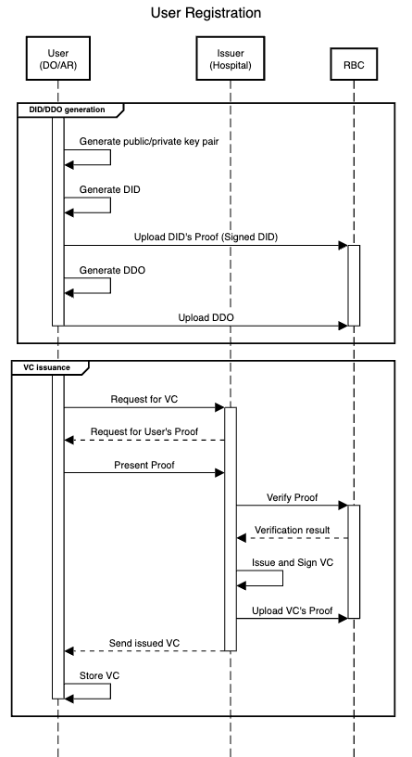
User Registration Process
8

Slide 9








9
EHR Encryption
AES-256
AES-256
EHR File
Encrypted EHR
EHR File
CP-ABE
CP-ABE
AES Key
Encrypted
AES Key
AES Key
PK
AR’s SK
Patient (DO)

Slide 10

10
EHR Decryption
AES-256
AES-256
EHR File
Encrypted EHR
EHR File
CP-ABE
CP-ABE
AES Key
Encrypted
AES Key
AES Key
PK
AR’s SK
Doctor (AR)

Slide 11

11
Proxy Re-Encryption (PRE)
CP-ABE
CP-ABE
Encrypted
AES Key
AES Key
Re-Encrypted AES Key
Proxy’s SK
AR’s PK
Proxy Gateway

Slide 12
12
Proxy Re-Encryption (PRE)
CP-ABE
CP-ABE
Encrypted
AES Key
AES Key
Re-Encrypted AES Key
Proxy’s SK
AR’s PK
CP-ABE
AES Key
AR’s SK
Doctor (AR)

Slide 13

A-PRE (Adaptive PRE)
In our system, the Proxy Gateway (PG) is designed and implemented on a cluster cloud computing platform. This design aims to handle the dynamically heavy load of processing numerous transactions.
Single Proxy
Multiple Proxies
When having less requests
Use single proxy instance
Dynamically increase number of proxies
When there are too many requests
13

Slide 14
Evaluation
Results
Comparative Analysis
Comparing XDHDS to normal approach which focused on cryptographic system, blockchain, and PRE performance

Slide 15



Experiment Environment Setup
Python 3.6.15 with Charm 0.50
Simulating cryptographic operation for our proposed system, XDHDS
Hyperledger Fabric
Implementing blockchain network and developing smart contract (Chaincode) to test data retrieval throughput and latency
Server
Intel(R) Xeon(R) E-2336 CPU @ 2.9GHz and 16 GB of RAM, running Ubuntu 20.04 OS
15

Slide 16
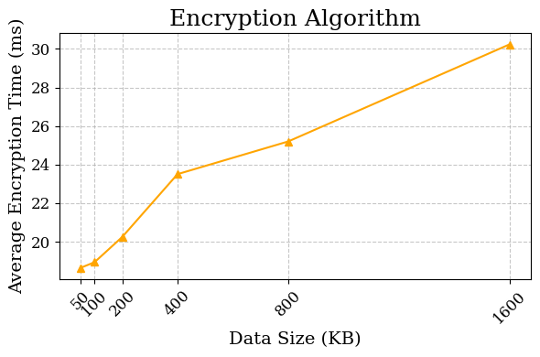
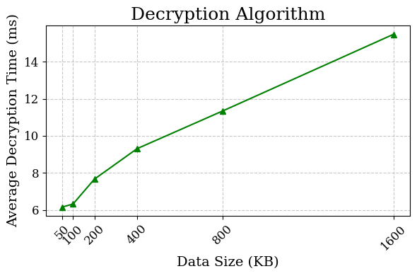
1)Cryptographic Performance Evaluation
Hybrid encryption using AES & CP-ABE
reduces computational overhead while maintaining security
16

Slide 17
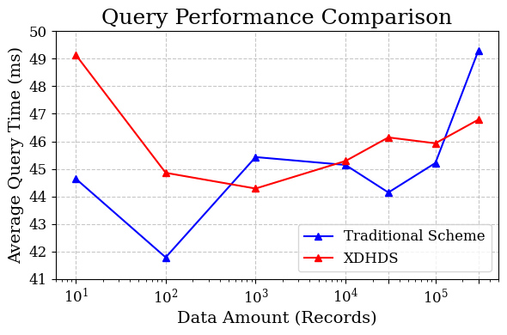
2) Data Access Performance
Slower query time
when small number of records
Faster query time
when large number of records
17

Slide 18
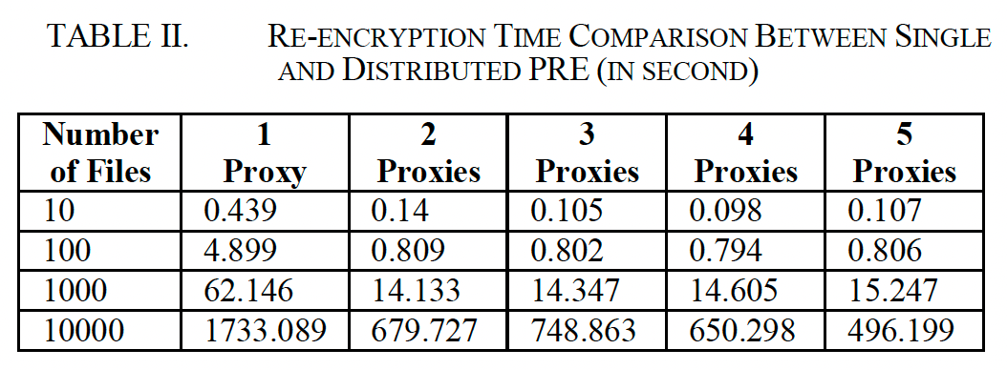


3) A-PRE Performance
More number of proxies, mostly less re-encryption time
18

Slide 19


Results & Discussion
XDHDS improves encryption efficiency, query performance, and re-encryption scalability, making it suitable for high-volume healthcare data sharing.
Efficient Hybrid Encryption
AES & CP-ABE reduces computational overhead while ensuring secure data handling.
Scalability for Large Datasets
Performs better than traditional blockchains for >150,000 records due to distributed RBCs.
Optimized Indexing
hid-based distributed indexing improves data retrieval speed, from O(n) to O(log n) or O(1).
Improved Re-Encryption Performance
Multi-proxy PRE reduces re-encryption time by 3.5x under high workloads.
19

Slide 20
Conclusion &
Future Works

Slide 21






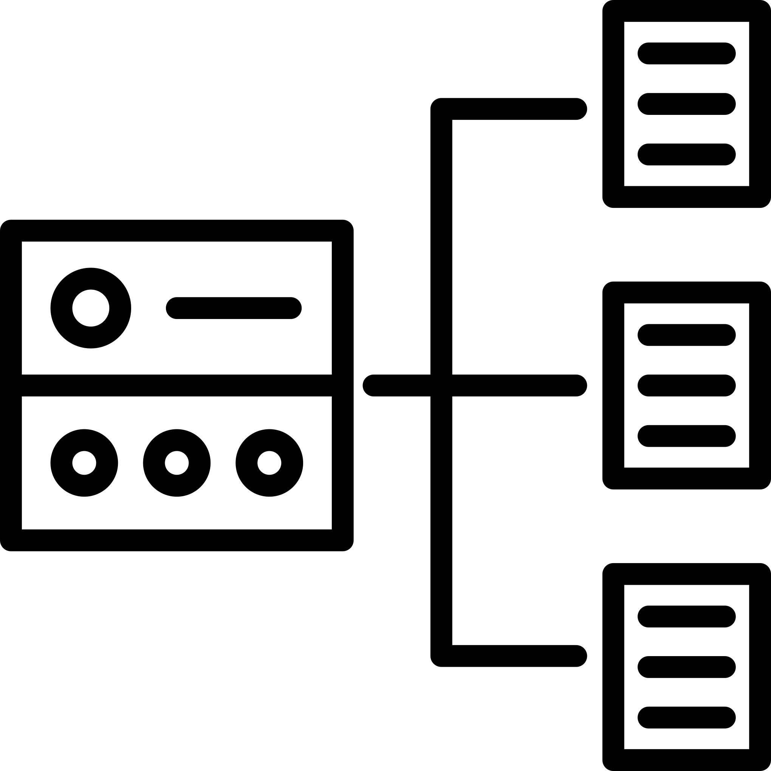
Conclusion
XDHDS provides a secure and scalable solution for cross-domain healthcare data sharing using SSI, blockchain, and proxy re-encryption. It enhances patient control, ensures data privacy, and enables efficient cross-regional access while reducing query contention in large datasets.
Limitations
Future Works
Challenges in dynamic environments may affect the efficiency of indexing
Enhancing data reliability with distributed backups and fault-tolerant storage
Optimizing dynamic indexing to improve efficiency in frequently updated datasets.
Fixed thresholds in Adaptive PRE may impact performance under varying workloads
Improving load balancing for high-concurrency performance
21

Slide 22
[1]
L. Xue, H. Huang, F. Xiao and W. Wang, "A Cross-Domain Authentication Scheme Based on Cooperative Blockchains Functioning With Revocation for Medical Consortiums," IEEE Transactions on Network and Service Management, vol. 19, no. 3, pp. 2409-2420, 9 2022.
References
[16]
H. Saidi, N. Labraoui, A. A. A. Ari, L. A. Maglaras and J. H. M. Emati, "DSMAC: Privacy-Aware Decentralized Self-Management of Data Access Control Based on Blockchain for Health Data," IEEE Access, vol. 10, pp. 101011-101028, 2022.
22

Slide 23

Thank You
XDHDS
Author
From
Danupat, Krittin, Teerawat, Somchart
SIIT, TU, Thailand

